Slide 1
Soft Prosthetics
Biomedical applications of soft robotics
Keene Chin, 16-848 Hands Presentation

Slide 2
A Brief Disclaimer About Quality
I procrastinated on this

Slide 3
A Brief Disclaimer About Quality
I procrastinated on this (a lot).

Slide 4
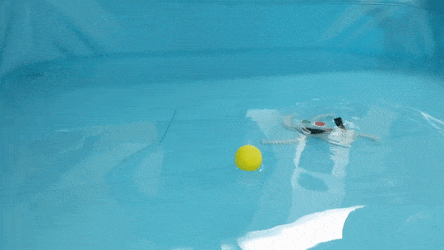
A Brief Disclaimer About Quality
I procrastinated on this (a lot).
Here’s why

Slide 5
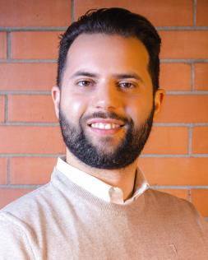
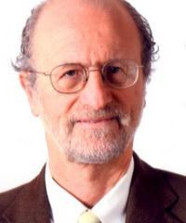
Meet the Authors!
All @ The BioRobotics Institute - Scuola Superiore Sant'Anna
Matteo Cianchetti
Cecilia Laschi
Arianna Menciassi
Paolo Dario
Notes:
Who are the authors? What do we know about their lab? What else have they done?

Slide 6
Meet the Authors!
Matteo Cianchetti -The BioRobotics Institute - Scuola Superiore Sant'Anna
A Bioinspired Soft Robotic Gripper for Adaptable and Effective Grasping
Cecilia Laschi
Soft-robotic arm inspired by the Octopus
Founding member of RoboTech SRL
Arianna Menciassi
Soft Robotics Technologies to Address Shortcomings in Today’s Minimally Invasive Surgery: The STIFF-FLOP Approach
Paolo Dario
Control of Multifunctional Prosthetic Hands by Processing the Electromyographic Signal

Slide 7
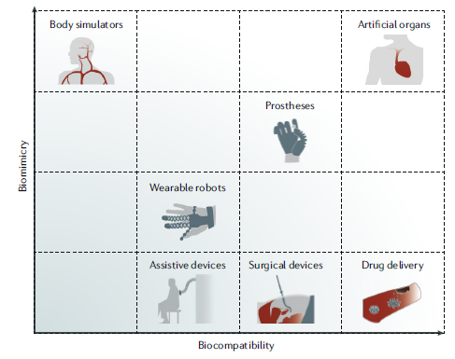
“Biomedical applications of soft robotics”
A survey of many applications of soft robots, including surgical tools
Notes:
What is the goal of the paper and why is it interesting and important? This is sometimes a good place to show a preview of results so we have an idea of what is coming.

Slide 8
“Biomedical applications of soft robotics”
A survey of many applications of soft robots, including surgical tools
HANDS!
Notes:
What is the goal of the paper and why is it interesting and important? This is sometimes a good place to show a preview of results so we have an idea of what is coming.

Slide 9
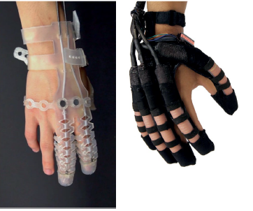
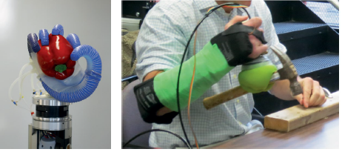
“Biomedical applications of soft robotics”
Wearable Robots
Soft Prosthetics

Slide 10
Wearable Soft Robots
Exo-Glove Poly
Cable - driven
Coupled-adaptive tendon routing
Soft robotic glove for combined assistance and at-home rehabilitation
Pneumatic
3 DOF per finger

Slide 11
“Soft robots mimicking the human body”
Morphological Intelligence: Programming primitives into materials
Methodology for designing and manufacturing complex biologically inspired soft robotic fluidic actuators: prosthetic hand case study
3D printed flexure hinges for soft monolithic prosthetic fingers
Hands “for Prosthetics”
5-DOF Anthropomorphic Grasper
Website showing grasp array
A novel type of compliant and underactuated robotic hand for dexterous grasping
Modeling and Prototyping of a Soft Prosthetic Hand Exploiting Joint Compliance and Modularity

Slide 12
“Soft robots mimicking the human body”
Prosthetic Hands
Prosthetic Jamming Terminal Device: A Case Study of Untethered Soft Robotics
XLimb

Slide 13
Discussion
Do the attempts at biomimicry seem well formulated?
Actuation strategies remain varied, what benefits actually seem relevant for decision making
Which approaches seem promising for enabling human dexterity
What concerns do you think should be kept in mind?
Notes:
n this section you should give your own opinion based on your study of the paper. Be sure to leave plenty of time for this section. Here are some questions to think about. Are the authors trying to solve an interesting problem in the first place? How good a job did they do? Are the results useful? To whom? What might you change or how might you solve this problem in a better way? Where do you expect the field to go from here, i.e., what important problems didn't the authors solve? Don't limit yourself to these questions -- just use them as a starting point to organize your own thoughts about the paper.

